Slide 1
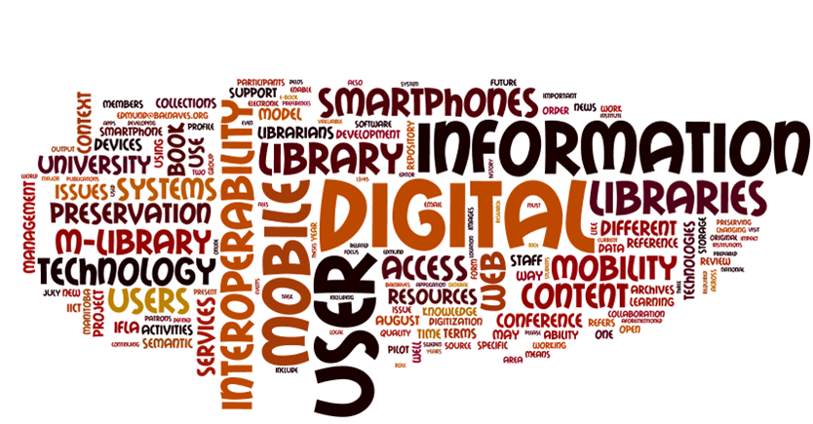
یکپارچه‌سازی معنایی در کتابخانه‌های دیجیتال
Information sharing from multiple heterogeneous sources is a challenging issue
(Bergamashi, et al, 1998)
مهدی علیپور حافظی
عضو هیئت علمی پژوهشگاه علوم و فناوری اطلاعات ایران

Slide 2
در یک نگاه
بخش اول
مفاهیم مربوط به یکپارچه‌سازی و ضرورت آن
بخش دوم
یکپارچه‌سازی در کتابخانه‌های دیجیتال
بخش سوم
یکپارچه‌سازی معنایی و اجزا و عناصر مطرح در آن

Slide 3
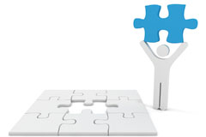
بخش اول
مفاهیم مربوط به یکپارچه‌سازی و ضرورت آن

Slide 4
What is the issue?
Access to information
Diversity in information carriers, such as web, profit and non-profit databases, etc. and essence of getting access by users.
Changes in users’ information behaviors
Rising costs of libraries and decrease of their budget
And so on.

Slide 5
What is metadata?
when trying to define metadata, two central questions need to be answered:
  What kinds of things is metadata about?
  What are the necessary characteristics of a metadata description?
Metadata is structured information that describes, explains, locates, or otherwise makes it easier to retrieve, use or manage an information resource (National Information Standards Organization, 2004).

Slide 6
Metadata classification
Descriptive metadata, both human-assigned information about a thing (such as name/title, subject and creator), and technical aspects of the thing (size, format, functionality, etc.)
Administrative metadata, such as information about the life cycle of a piece of information (different versions, history, etc.)
Structural metadata, describing relations between and aggregations of things (such as the relationship between a lesson and its comprising learning objects) (National Information Standards Organization, 2007)

Slide 7
What is integration?
A system is an aggregation of subsystems cooperating.
systems integration is the process of linking together different computing systems and software applications physically or functionally, to act as a coordinated whole.

Slide 8
What is interoperability?
The ability of two or more systems or components to exchange information and to use the information that has been exchanged. (IEEE Standard Computer Dictionary, 1990)
Metadata interoperability: the ability of two or more systems or components to exchange descriptive data about things, and to interpret the descriptive data that has been exchanged in a way that is consistent with the interpretation of the creator of the data.

Slide 9
Levels of interoperability
Syntactic interoperability: If two or more systems are capable of communicating and exchanging data, they are exhibiting syntactic interoperability.
  Syntactical interoperability is a necessary condition for further interoperability.
Semantic interoperability: Beyond the ability of two or more computer systems to exchange information, semantic interoperability is the ability to automatically interpret the information exchanged meaningfully and accurately in order to produce useful results as defined by the end users of both systems.

Slide 10
What is Harmonization?
Metadata harmonization refers to the ability to correctly process several different metadata standards in combination within a single software system.
  Vertical harmonization. interoperability on different levels within a given set of standards, based on pre-coordination of a base standard.
  Horizontal harmonization. interoperability based on interoperability across standards, i.e. post-coordination not based on a common standard

Slide 11
بخش دوم
یکپارچه‌سازی در کتابخانه‌های دیجیتال

Slide 12
What is expected?
Heterogeneous systems can interact with each other.
Data are exchanged.
Information retrieval is expanded.
Reduced cost of information resources in digital libraries.
Etc.

Slide 13
Interoperability in DLs
There is a long history for the interoperability in other fields, such as e-banking, medical fields, etc.
The Internet provided a good platform for the exchange of information.
Report of research and practical experiences emerged from 1998
This function is in progress according to new emerging technologies.

Slide 14
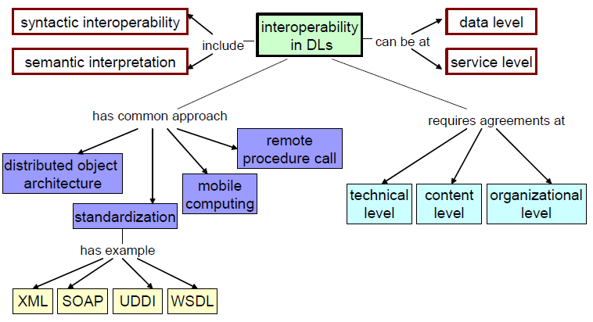
Various aspects of interoperability in DLs
Shen, Rao (2006). Applying the 5S framework to integrating digital libraries. Dissertation for the Doctor of Philosophy in Computer Science and Application. Virginia Polytechnic Institute and State University.

Slide 15
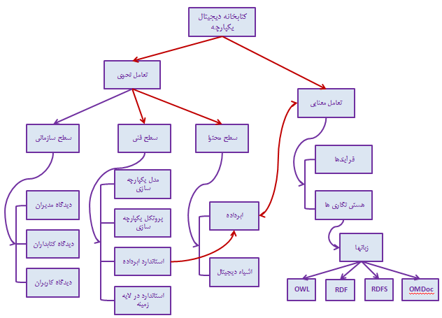

Slide 16
بخش سوم
یکپارچه‌سازی معنایی و اجزا و عناصر مطرح در آن

Slide 17
What is expected?
Metadata standards can interact with each other
Metadata standards can be combined with each other.
Semantic retrieval is possible especially in heterogeneous information systems.
Accuracy of the data in information retrieval increases.

Slide 18
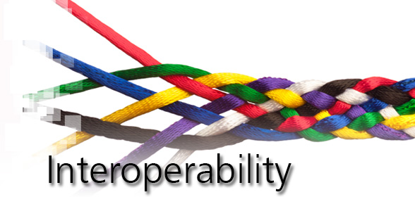
What is semantic Interoperability?
Semantic interoperability in DLs means the capability of different information systems to communicate information consistent with the intended meaning.

Slide 19
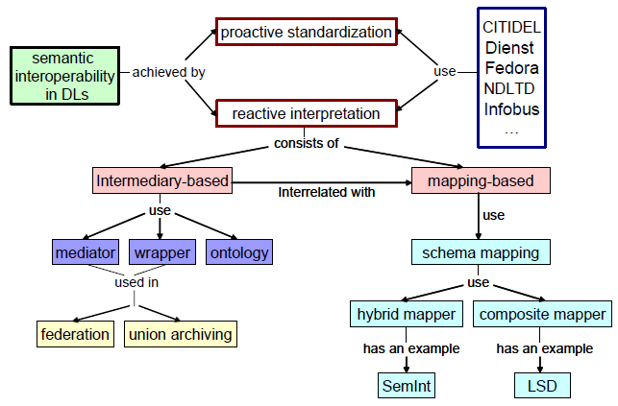

Slide 20
Levels of semantic metadata interoperability
In semantics of terms that used in metadata standard. giving each term an universal identifier in the form of a URI and formal relationships to other terms.
  Such as “creator” being a sub-property of “contributor” in DC.
In semantics of content. Making content of metadata fields semantically related to each other.

Slide 21
Metadata interoperability issues
At a first glance, the major problem of metadata interoperability seem to be about formats: the different standards all use different methods of encoding their information.
Nowadays, many standards use XML-based encodings, but using XML is not a guarantee for interoperability.

Slide 22
Fundamental principles for metadata interoperability
Extensibility: ability to create structural additions to a metadata standard
Modularity: ability to combine metadata fragments adhering to different standards.
Refinements: ability to create semantic extensions
Multilingualism: ability to express, process and display metadata in a number of different linguistic and cultural circumstances
(Duval, Hodgins, Sutton, and Weibel, 2002)
Machine-processability: ability to automate processing of different aspects of the metadata specifications (Nilsson et al 2006)

Slide 23
Resource description Framework (RDF)
RDF was designed as an extensible framework for metadata descriptions.
It was created in 1999, within the Semantic Web initiative at the World Wide Web Consortium (W3C).
The core model of RDF is specified in Resource Description Framework (RDF): Concepts and Abstract Syntax.
  This model defines the interpretation of RDF metadata and how to construct RDF descriptions
Abstract models are essential in understanding metadata harmonization issues.

Slide 24
RDF (2)
RDF/XML Syntax Specification, defining an XML-based expression of RDF metadata.
RDF Vocabulary Description Language: RDF Schema specification defines how to describe vocabularies for use in RDF metadata
The formal semantics of RDF and RDF Schema is defined mathematically in RDF Semantics.
This semantics is the basis for the ontology specifications of the W3C, OWL Web Ontology Language from 2004 and the more recent OWL 2 Web Ontology Language.
RDF is more than a syntax, as it also carries semantics.

Slide 25
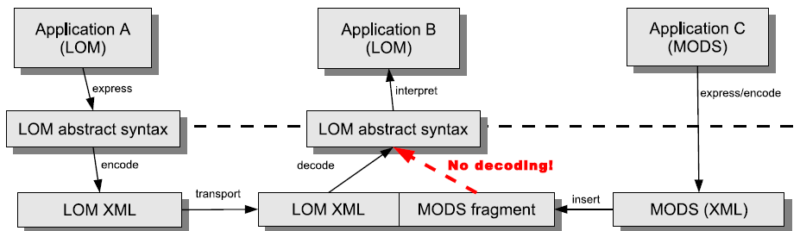
Extending LOM with a MODS fragment (an example)

Slide 26
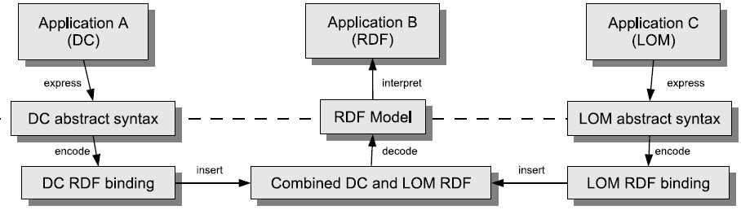
Combining RDF metadata from LOM and DC (an example)

Slide 27
Major problems in metadata mapping or cross-walk
Every mapping requires manual construction
The differences in abstract models, terminology and vocabulary necessarily make mappings incomplete and sometimes ambiguous
Each new metadata standard requires a new set of mappings to each other relevant standard
Semantic information tends to be lost.
Mappings do not really solve the problem of combining parts from different standards

Slide 28
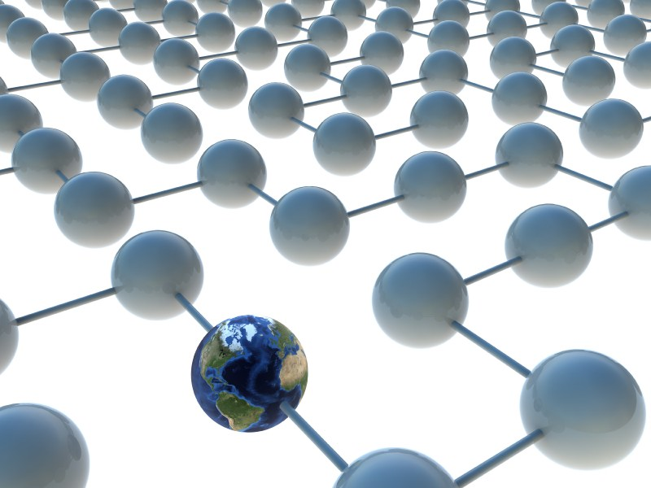
In semantics of content
There are two main models in integrating digital library contents:
  Harvesting
  Federated

Slide 29
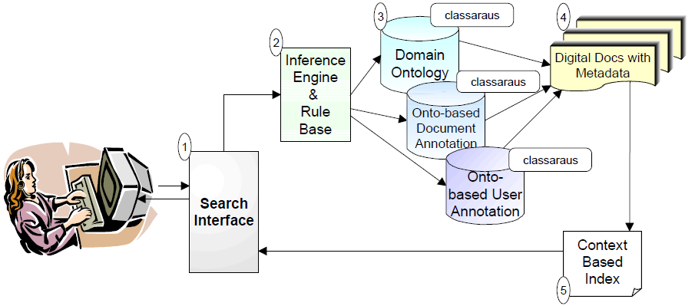
In semantics of content: Harvesting

Slide 30
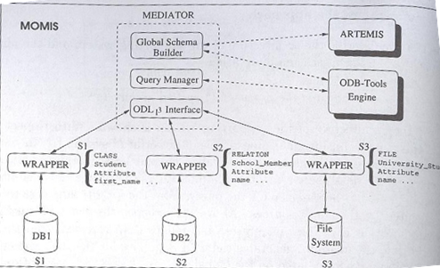
In semantics of content: Federated

Slide 31
Conclusion
Integrating digital libraries is essential now
There are two major steps in interoperability: Syntactic and Semantic
There are two main levels of semantic metadata interoperability: In semantics of terms, In semantics of content
There are two main models in integrating digital library contents: Harvesting, Federated

Slide 32
Some important resources
Bergamaschi, S.; Castano, S.; De Capitani di Vimercati, S.; Montanari, S.; Vincini, M. (1998). An intelligent approach to information integration. In formal ontology in information systems. IOS Press.
Kalfoglou, Yannis (2010). Cases on semantic interoperability for information systems integration: practices and applications. Information Science Reference (an imprint of IGI Global).
National Information Standards Organization (NISO) (2004), Understanding Metadata, Bethesda, MD, NISO Press. http://www.niso.org/publications/press/UnderstandingMetadata.pdf
National Information Standards Organization (NISO) (2007), A Framework of Guidance for Building Good Digital Collections, 3rd ed., A NISO Recommended Practice, NISO, Baltimore, USA. http://framework.niso.org/
Shen, Rao (2006). Applying the 5S framework to integrating digital libraries. Dissertation for the Doctor of Philosophy in Computer Science and Application. Virginia Polytechnic Institute and State University.
Duval, E., Hodgins, W., Sutton, S. & Weibel, S. L. (2002), Metadata Principles and Practicalities, D-Lib Magazine, April 2002. http://www.dlib.org/dlib/april02/weibel/04weibel.html

Slide 33
Some important resources (2)
Nilsson, M., Johnston, P., Naeve, A., Powell, A. (2006a), The Future of Learning Object Metadata Interoperability, in Koohang A. (ed.) Learning Objects: Standards, Metadata, Repositories, and LCMS. http://kmr.nada.kth.se/papers/SemanticWeb/FutureOfLOMI.pdf
Nilsson, M., Mason, J., Naeve, A., Powell, A., Johnston, P., Baker, T., Sutton, S., Hillmann, D. I. (2006b), DCMI Comments on WG4 N0145: Working Draft for ISO/IEC 19788-2 . Metadata for Learning Resources . Part 2: Data Elements, ISO IEC JTC1 SC36 Liaison comment, N1203, http://isotc.iso.org/livelink/livelink?func=ll&objId=4993430&objAction=Open
Nilsson, M., Naeve, A. (2010), Metadata harmonization: a roadmap for standardization, submitted for publication.
Nilsson, M. (2010). From Interoperability to Harmonization in Metadata Standardization: Designing an Evolvable Framework for Metadata Harmonization. Doctoral thesis, Stockholm, Sweden.

Slide 34
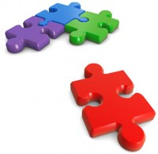
با تشکر از حوصله شما

Slide 35
Wrapper
Responsible for translating the structure of the data source into the common data language (ODL)
Also translation is made by the wrapper for the query, from the CQL to a local request executed by the single sources.

Slide 36
Mediator
A software module that combine, integrates, and refine data received from the wrappers.
Also mediator generates the CQL queries for the wrappers, starting from the query request formulated on the global schema.
Mediator modules is obtained by coupling a semantic approach (i.e., ODB tools engine) and on a clustering component (i.e., ARTMIS tool)

