Slide 1
شخصی سازی و مدلسازی ترجیحات کاربر در ارتباطات سیار
یا لطیف
ارائه کننده:
الهه همایون والا
پژوهشگاه علوم و فناوری اطلاعات
آبان 1389

Slide 2
عناوین مورد بحث
تعریف شخصی سازی
ارائه مثال از شخصی سازی
خاستگاه شخصی سازی
شخصی سازی صریح و ضمنی/ شخصی سازی و سفارشی سازی
شخصی سازی وب
چهار نسل از کاربردهای شخصی ساز
چالشهای شخصی سازی
پروفایل کاربر، محیط یادگیری (قطعی، غیر قطعی)
شخصی سازی در ارتباطات سیار
ابعاد شخصی سازی در ارتباطات سیار
مدل سازی ترجیحات کاربر
انتخاب دسترسی رادیویی در محیط های ارتباط چند دسترسی
شبکه بیزین
استخراج خودکار ترجیحات کاربر

Slide 3
تعریف شخصی سازی
The ability to customise each individual user’s experience of electronic content”.
توانایی شخصی کردن تجربه کاربران از محتوای الکترونیک
In personalisation, information about a user is applied in order to design products and services better by tailoring them to the user
در شخصی سازی، اطلاعاتی در مورد کاربر به منظور طراحی محصولات و خدمات بهتر با تطبیق آنها به کاربر، مورد استفاده قرار می گیرد.

Slide 4
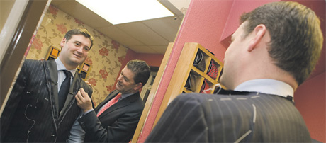
شخصی سازی یعنی چه؟
در شخصی سازی، اطلاعاتی در مورد کاربر به منظور طراحی محصولات و خدمات بهتر با تطبیق آنها به کاربر، مورد استفاده قرار می گیرد.
کاربر در این تعریف می تواند مشتری، بازدید کننده از یک وب سایت، یک فرد و یا یک گروه از افراد باشد.
اطلاعات کاربر هم می تواند هر نوع اطلاعاتی از مکان جغرافیایی کاربر گرفته تا سن و جنسیت و علایق شخصی باشد.

Slide 5
یک مثال از شخصی سازی
Amazon.com
Online shopping from the earth's biggest selection of books, magazines, music, DVDs, videos, electronics, computers, software, apparel & accessories, shoes, ...

Slide 6
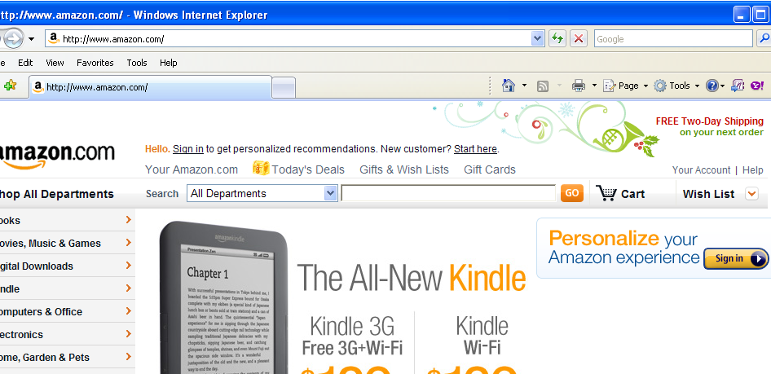

Slide 7
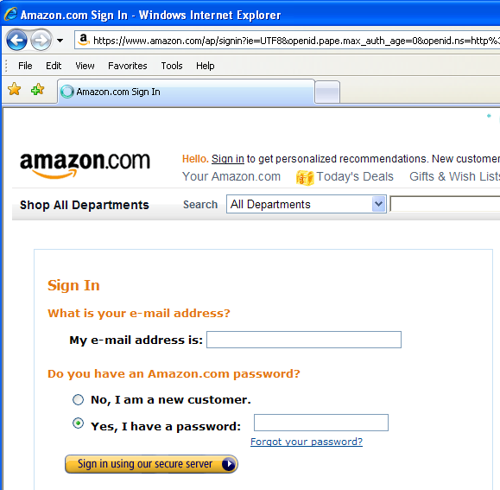

Slide 8
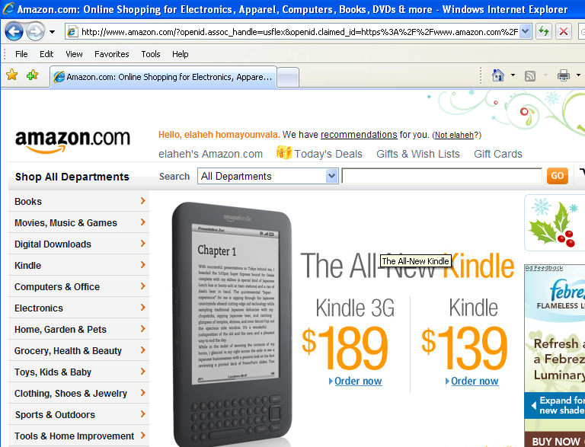

Slide 9
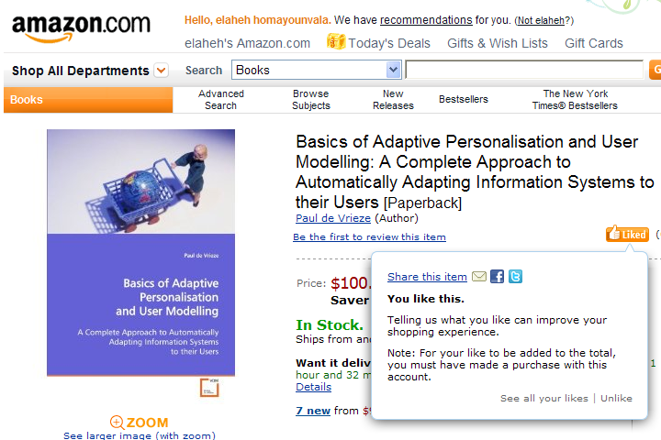

Slide 10
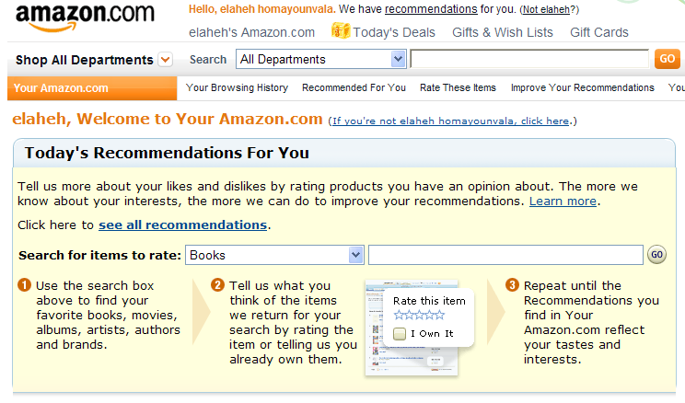

Slide 11
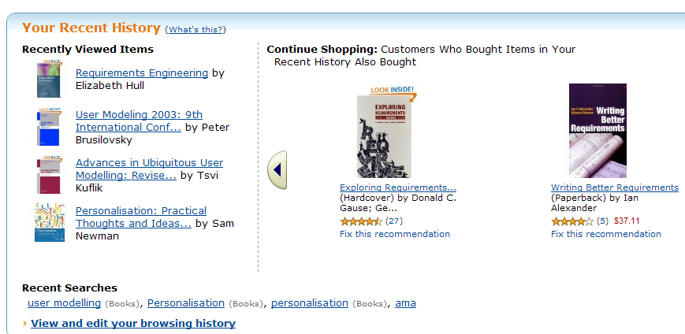

Slide 12


Slide 13
Origins of personalisation 1
خاستگاه شخصی سازی 1
1) In the context of information filtering to select useful and relevant information in a large body of information.
Example:
Receiving special television programs by a viewer

Slide 14
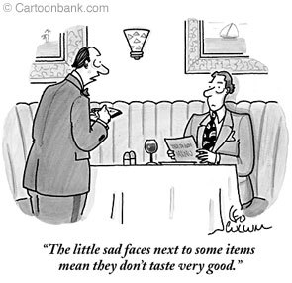
Origins of personalisation 2
خاستگاه شخصی سازی 2
2) In the business context of supporting one-to-one marketing, both in conventional and electronic commerce, where marketing is tailored to a group of individual customers among the entire population of customers.
Examples:
waiter/waitress,
Sending promotional materials or offering promotional deals to a group of customers.

Slide 15
A framework for personalised information systems

Slide 16
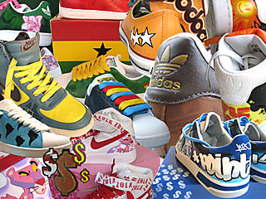
Personalisation vs. Customisation
شخصی سازی و سفارشی سازی
In some studies such, the distinction between implicit and explicit personalisation is considered as the difference between personalisation and customisation respectively.
who performs the personalisation?
  The system -> Personalisationشخصی سازی
  The user -> Customisationسفارشی سازی
Customisation is done manually by the user and the system is almost passive. Example: My yahoo
In personalisation the system automatically personalises a service or product based on the history of previous interactions with the user. Example: recommendations in Amazon

Slide 17
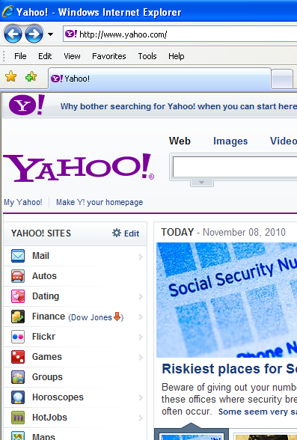

Slide 18
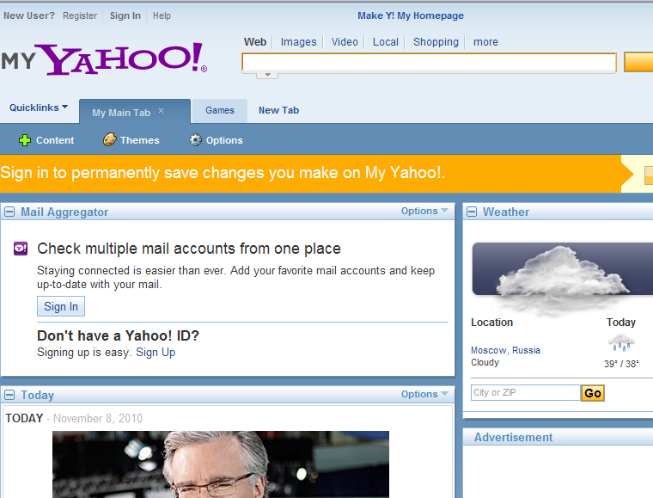

Slide 19
Web personalisation
Different approaches to web personalisation
  Content personalisation شخصی سازی محتوا
    Cognitive filtering (content-based)
    Collaborative filtering (social systems)
  Control personalisation شخصی سازی کنترل
  Link personalisation شخصی سازی اتصال
  Example: “favourites” in internet explorer (explicit link personalisation)
  Customised screen design personalisation
  شخصی سازی سفارشی طرح صفحه
  Example: My yahoo
  Anthropomorphic personalisation (acts like a human)
  شخصی سازی شبهه انسانی

Slide 20
Personalisation challenges
چالشهای شخصی سازی
In web filtering applications:
  A representation of a web page
  A representation of the user’s interests
  A function to determine the pertinence of a web page given a user’s interests
  A function returning an updated user profile given the user’s feedback on a page

Slide 21
Personalisation challenges
چالشهای شخصی سازی
Personalisation challenges can be classified into two main categories:
User and context modelling
Adaptation
  Adapting the content/interface to the user and context model
  Adapting the user and/or context model to user’s feedback

Slide 22
Personalisation challenges

Slide 23
User profile پروفایل کاربر
The user profile may consist of many pieces of information such as
User static data (name, DoB, ...)
user needs
preferences
history
behaviour
location-related aspects
technical specifications
ambient conditions
or even business rules that apply.

Slide 24

Learning environment, deterministic or uncertain?قطعی یا غیر قطعی
Learning : Adapting user model to new observations.
Sometimes the environment in which observations are made is deterministic and also it is possible to observe enough facts to reach an optimum solution for the problem.
However, in many real world problems, prevalence of uncertainty affects the learning and reasoning procedure and demands different types of learning and reasoning algorithms.
User modelling ->uncertain domain
?

Slide 25
Learning from observations under uncertainty
Probability theories and statistical learning methods are applied for learning from observations under uncertainty.
The main statistical learning methods applied to user modelling:
  Neural networks
  Classification
  Rule induction
  Bayesian networks
    Able to predict more than one variable
    Represents causal relationships
    The only approach in which “persistence of interests” is not an assumption

Slide 26
Challenges associated with machine learning for user modelling
Regardless of the modelling technique applied for machine learning, there are some challenges specifically associated with machine learning for user modelling, some of these challenges are:
  The need for large data sets
  The need for labelled data
  Concept drift (dynamicity of user interests)
  Computational complexity (millions of visitors in web personalisation)

Slide 27
Four generations of personalisation applications
Web personalisation
E-commerce
Mobile services <-
Personalisation in physical space

Slide 28
Personalisation in telecom
W3C
Virtual Home Environment
WWRF I-centric vision

Slide 29
W3C
The World Wide Web Consortium (W3C) is an international community that develops standards to ensure the long-term growth of the Web.
The W3C seems to be the oldest standardisation effort for personalisation.
It has developed a protocol standard called the Composite Capability/Preference Profile (CC/PP).
This protocol is used by the Open Mobile Alliance (OMA) [14], formerly known as the WAP Forum, to make a User Agent Profile (UAProf) to describe and transmit Capability and Preference Information (CPI) about the client, user and network.

Slide 30
Complete CC/PP profile example

Slide 31
3GPP’s Virtual Home Environment
The 3rd Generation Partnership Project (3GPP) is a collaboration between groups of telecommunications associations, to make a globally applicable third-generation (3G) mobile phone system specification.
3GPP defines VHE as “a concept for Personal Service Environment (PSE) portability across network boundaries and between terminals”.
The goal of VHE is to present users with the same personalised features, user interface customisation and services in any network, in all kind of terminals and wherever the user may be located.

Slide 32
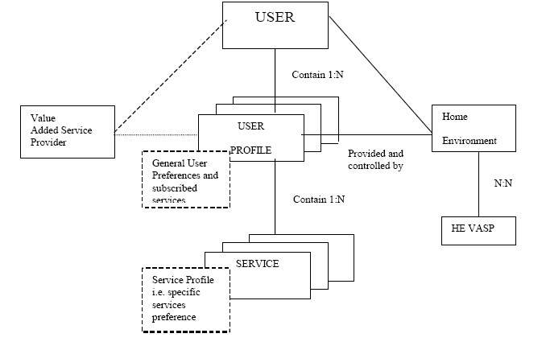
Virtual Home Environment

Slide 33
WWRF’s I-Centric Communications
WWRF: Wireless World Research Forum
The objective of the forum is to formulate visions on strategic future research directions in the wireless field, among industry and academia, and to generate, identify, and promote research areas and technical trends for mobile and wireless system technologies.
آینده پژوهی/ آینده نگاری ارتباطات سیار

Slide 34
WWRF’s I-Centric Communications
Personalization
Personalized services that automatically reflect user needs
  consensus: profile format & categories, standards to exchange profiles & secure privacy sensitive parts
  integrate all personalization aspects
  profile learning functionality
  distributed, loosely coupled, personalization architecture

Slide 35
RM for I-Centric Communications
Communication Space
(Contexts & Objects)
User Model & Appl. Scenarios
Ambient
Awareness
Personalization
Adaptation
Service Semantic
Service
Bundling
Service
Control
Service
Discovery
Service
Creation
Environment
Monitoring
Service
Deployment
Conflict
Resolution
Generic Service Elements
for all layers
Application Support Layer
Business Model
Service Execution Layer
Service Platform
Service Support Layer
IP based
Communication
Subsystem
Network Control & Management Layer
IP Transport Layer
Networks
Wired or wireless Networks
Terminals
Devices and Communication
End Systems

Slide 36
Dimensions of personalisation in telecommunications
ابعاد شخصی سازی در ارتباطات سیار
  Different sources of content
  Arrangement of content on the screen
  Delivery mechanism (push/pull)
  Delivery vehicle
Other dimensions:
  Variety of access technologies
  Variety of contexts

Slide 37
User profiles in mobile communications
Includes information such as
the priority order of the access selection,
acceptable monthly cost,
privacy requirement,
types and preferable settings of services used daily, which are more steady,
as well as those are more temporary such as preferable settings and requirements of occasionally used applications,
or even more abstract information such as user personality and behaviours.
Generally speaking, any information that characterises the user, the device, the infrastructure, the context, and the content involved in a service request, in order to help offering a better response to a request, is called a user profile.

Slide 38
Personalisation in mobile communications spans over several field of research

Slide 39
ترجیحات کاربر
User modelling:
  Static data
  dynamic data
    User behavior
    User preferences
    ...

Slide 40
User Profiles, Static or Dynamic?
User profiles are not static and can change in many dimensions.
For example user preferences may change for different budget limitations, or a mobile user’s resources may change when moving from one cell to another in a cellular network.
Gathering these kinds of information and more importantly, keeping them up-to-date with the changing needs and context of the user is a crucial issue.

Slide 41
Information that is stored in a user profile is usually
application dependent and varies from one application to the other.
distributed and different entities manage distinct parts of the user profile, while some entities need to access the whole user profile.
For instance user location is usually provided by the network operator while personal data is provided by the user.

Slide 42
User profiles
Access rules needs to be defined for different parts of the profile and its entities, as well as a protocol for applying those rules in a user-transparent manner.
Producing a user profile capable of predicting the user’s future actions requires a very large time corresponding to a very large training set.
User wishes are usually incomplete, inaccurate and even contradictory, and it is difficult to interpret them into a set of precise rules suitable to be used in personalisation.

Slide 43
User Profiling Assumption
In user profiling the assumption is that user behaviour is not completely unpredictable and in the long term is somehow correlated to the user’s performance in the past.

Slide 44
Radio access selection problem
مسئله انتخاب دسترسی رادیویی
Multiple radio access environments are fast becoming a necessity for future wireless telecommunications systems and result, in a large part, from the rapid deployment of a variety of access technologies over the past few years.
The realisation of multi-access environments that support different radio access technologies with the ability to switch to the “best” access based on both application requirements and user preferences, will greatly enhance the consumer experience.

Slide 45
Access Selection
“Access selection refers to the process of deciding over which access network to connect at any point in time”.
Choosing the “best” radio access technology is not a trivial task and there are a number of parameters to take into account when selecting the “best” access.

Slide 46
Access Selection parameters
پارامترهای انتخاب دسترسی
Personal preferences
Size and capabilities of the device
Application requirements
Security
Operator or corporate policies
Available network resources
Network coverage
are among the parameters that define the “best” access technology according to the Always Best Connected (ABC) concept.

Slide 47
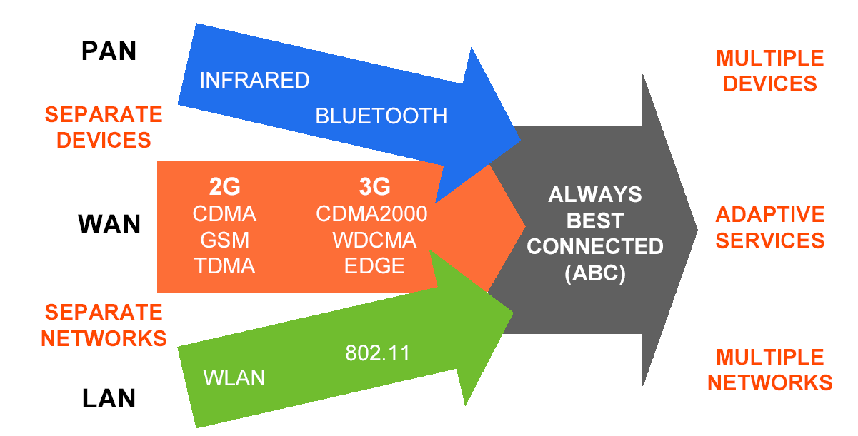
Enabling multi-access services with the always best connected concept

Slide 48
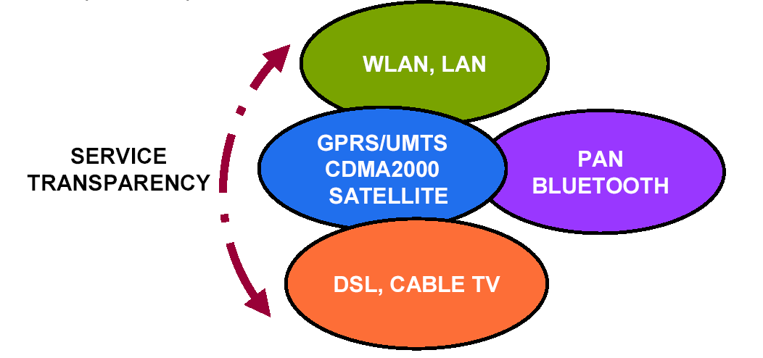
ABC end-user vision

Slide 49
Access selection from user perspective
انتخاب دسترسی از منظر کاربر
Network and physical layer issues of access selection to maximize network performance have been the subject of study for many researchers, but access selection from a user perspective has received comparatively less attention in the literature.

Slide 50
Interaction between Preference Model, Access Selector and User

Slide 51
Bayesian approach
The Bayesian approach has been chosen because the technique has been extensively applied to preference modelling in other domains such as information retrieval and web-based applications.
The dynamic and uncertain nature of users’ preferences suits probabilistic techniques and more specifically Bayesian networks.

Slide 52
Nature of user preferences?
طبیعت ترجیحات کاربر چیست؟
User preferences are users’ beliefs of what is better than the other.
This interpretation suits the Bayesian view of the probability that interprets probabilities as the “degree of belief” about events in the world and data is used to strengthen, update or weaken these degrees of belief.
Bayesian networks are used for decision making under uncertainty.

Slide 53
The uncertainty in the access selection problem domain comes from four aspects
ریشه های عدم قطعیت در مسئله انتخاب دسترسی
First, users have individual preferences in terms of affordable cost, acceptable quality of service and other selection parameters.
Secondly, preferences of a single user might change over time. For instance user’s cost expectation or expected level of quality of service is subject to change.
Thirdly, users make different tradeoffs between access selection parameters. For instance, one user might value reputation statistics greatly and choose a high profile access network even with a higher price, and another user might not trust reputation statistics and choose the less expensive offer regardless of access network reputation.

Slide 54

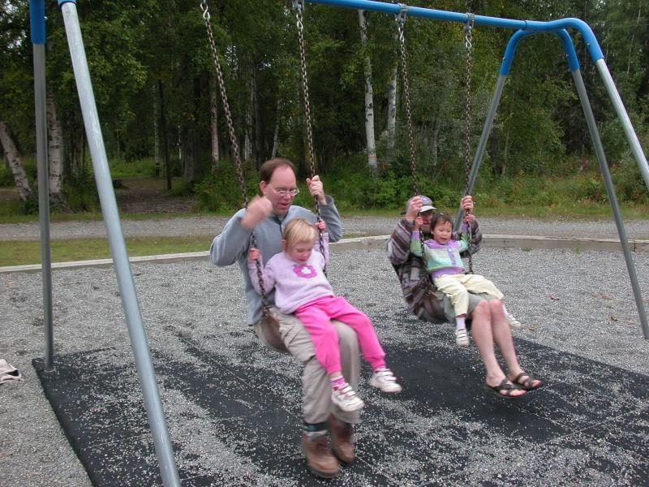
The uncertainty in the access selection problem domain comes from four aspects
ریشه های عدم قطعیت در مسئله انتخاب دسترسی
Finally, user preferences in terms of cost and quality of service vary depending on the current user context. As an example, a user might value quality of service regardless of cost in the business context, but the same individual might want to minimise the cost without considering the quality of service in a leisure context.

Slide 55
Bayesian Network شبکه بیزین
The Bayesian network formalism was invented to allow efficient representation of, and rigorous reasoning with, uncertain knowledge.
Bayesian networks can be applied in virtually unlimited applications and domains such as:
  Diagnosis
  Forecasting
  Sensor fusion
  Manufacturing control.
They “now dominate AI research on uncertain reasoning” [Russell & Norvig book on AI]

Slide 56
Bayesian Network
A Bayesian network consists of a directed acyclic graph (DAG) with the set of variables and conditional probability tables (CPTs) of P(A|B₁, B₂, …, B_{n}), associated with each variable. B_{i} terms are parents of A and each variable has a finite set of mutually exclusive states.

Slide 57
Bayesian Network
The joint probability of the variables can be calculated by the chain rule for Bayesian networks as follows:
The structure of the Bayesian network itself can answer questions on dependence between variables. The most common task to be performed with Bayesian networks is probabilistic inference.

Slide 58
X_{j} is a set of observed variables. They are also called information variables or predictive attributes.
X_{i} represents a set of hidden variables for which we are interested in calculating probabilities. They are also called hypothesis variables or target attributes. Observation of hypothesis variables is either impossible or too costly.
X_{k} are mediating variables. These variables are introduced for a special purpose. For instance they can be introduced to facilitate the acquisition of conditional probabilities.

Slide 59
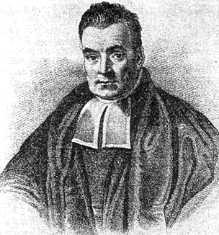
Baye’s Theoreme
Using the Bayes’ theorem we can update our belief in hypothesis H given an additional evidence E and the background context C.
P(H|E,C) represents the posterior probability of the hypothesis given the evidence.
P(E|H) is the likelihood of the evidence given the hypothesis. P(H) represents the prior probability of the hypothesis and P(E) is the normalising constant.

Slide 60
مثال استارت اتومبیل
“In the morning my car will not start. I can hear the starter turn, but nothing happens. There may be several reasons for my problem. I can hear the starter roll, so there must be power in battery. Therefore the most probable causes are that the fuel has been stolen overnight or that the spark plug is dirty. It may also be due to the dirt in the ignition system, or something more serious. To find out, I first look at the fuel meter. It shows ½ full, so I decide to clean the spark plugs.”

Slide 61
مثال استارت اتومبیل
P(CSP | St= No, FMS = ½ ) = ?

Slide 62
Bayesian network for modelling user preferences for access selection
مدلسازی ترجیحات کاربر توسط شبکه بیزین برای انتخاب دسترسی رادیویی
Service
Cost
QoS
Access Network

Slide 63
Conditional probability tables of the Bayesian network

Slide 64
Context
Context-aware user preference modelling
Example:
  Business Context and
  Leisure Context
Different CPTs in each context

Slide 65
This model can provide answers to these preference related queries:
How much is the affordable cost for this service in this context?
What is the acceptable level of quality of service for this service in this context?
What is the most preferable access network for this service, QoS and cost in this context?
What are the acceptable QoS, affordable cost and most preferred access network for this service in this context? (which access network, cost and QoS are more likely to be chosen?)

Slide 66
This model can provide answers to these preference related queries:
Which of the offered choices of cost, QoS and access network are most preferable for this user for this service?

Slide 67
Learning Algorithm
A large set of data is gathered
Data is divided into two sets : training and test set
Learning algorithm is applied to each experience in the training set
Proportion of correct predictions compared to test set is measured
Steps 2-3 are repeated for all experiences in the training set
Step 2-5 are repeated for five different training and test sets

Slide 68
Learning curve

Slide 69
Change of preferences in P(N=AN1 | S) during the learning process in business context, no fading factor
A fading factor is a number between 0 and 1 and models the rate at which older experiences are forgotten.

Slide 70
Change of preferences in P(N=AN1 | S) during the learning process in business context, fading factor=0.7

Slide 71
خلاصه
شخصی سازی
  تعریف
  ارائه مثال
  خواستگاه
  صریح و ضمنی/ شخصی سازی و سفارشی سازی
  شخصی سازی وب
  چهار نسل از کاربردهای شخصی ساز
  چالشها
شخصی سازی در ارتباطات سیار
شخصی سازی از طریق لحاظ کردن ترجیحات کاربر
مدل سازی و استخراج خودکار ترجیحات کاربر درانتخاب دسترسی رادیویی

Slide 72

با تشکر از توجه شما
پرسش و پاسخ
الهه همایون والا
elaheh_h_vala@yahoo.co.uk

