Slide 1


بسم الله الرحمن الرحیم

Slide 2
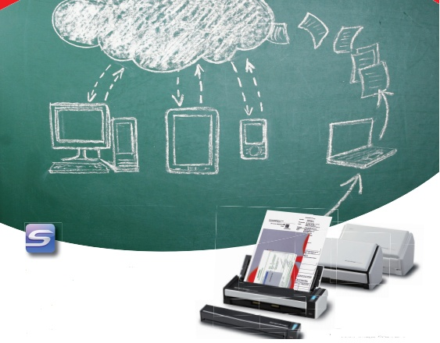

Outline of presentation
General introduction of cloud computing and Mobile cloud computing (MCC)
Incentives of wireless operators to utilize the MCC,
Implementation challenges of MCC,
New researches on MCC .

